Slide 1


Maiara Taniguchi
2022

Slide 2

Section 1

Slide 3

Methodology
Executive Summary
Data collection methodology:
Data was collected using SpaceX API and web scraping from Wikipedia
Perform data wrangling
Describe how data was processed
Perform exploratory data analysis (EDA) using visualization and SQL
Perform interactive visual analytics using Folium and Plotly Dash
Perform predictive analysis using classification models
How to build, tune, evaluate classification models

Slide 4
Data Collection
The Get Request was used to connect through the SpaceX API to collect data, clean the requested data as well as Web scraping. Data wrangling and formatting was performed.

Slide 5
Data Collection – SpaceX API
Present your data collection with SpaceX REST calls using key phrases and flowcharts
Add the GitHub URL of the completed SpaceX API calls notebook (must include completed code cell and outcome cell), as an external reference and peer-review purpose
Place your flowchart of SpaceX API calls here

Slide 6
Data Collection - Scraping
Present your web scraping process using key phrases and flowcharts
Add the GitHub URL of the completed web scraping notebook, as an external reference and peer-review purpose
Place your flowchart of web scraping here

Slide 7
Data Wrangling
Describe how data were processed
You need to present your data wrangling process using key phrases and flowcharts
Add the GitHub URL of your completed data wrangling related notebooks, as an external reference and peer-review purpose
https://github.com/maiataniguchi/capstone_coursera

Slide 8
EDA with Data Visualization
Summarize what charts were plotted and why you used those charts
Add the GitHub URL of your completed EDA with data visualization notebook, as an external reference and peer-review purpose

Slide 9
EDA with SQL
Using bullet point format, summarize the SQL queries you performed
Add the GitHub URL of your completed EDA with SQL notebook, as an external reference and peer-review purpose
https://github.com/maiataniguchi/capstone_coursera

Slide 10
Build an Interactive Map with Folium
Summarize what map objects such as markers, circles, lines, etc. you created and added to a folium map
Explain why you added those objects
Add the GitHub URL of your completed interactive map with Folium map, as an external reference and peer-review purpose
https://github.com/maiataniguchi/capstone_coursera

Slide 11
Build a Dashboard with Plotly Dash
Summarize what plots/graphs and interactions you have added to a dashboard
Explain why you added those plots and interactions
Add the GitHub URL of your completed Plotly Dash lab, as an external reference and peer-review purpose

Slide 12
Predictive Analysis (Classification)
Summarize how you built, evaluated, improved, and found the best performing classification model
You need present your model development process using key phrases and flowchart
Add the GitHub URL of your completed predictive analysis lab, as an external reference and peer-review purpose

Slide 13
Results
Exploratory data analysis results
Interactive analytics demo in screenshots
Predictive analysis results

Slide 14

Section 2

Slide 15
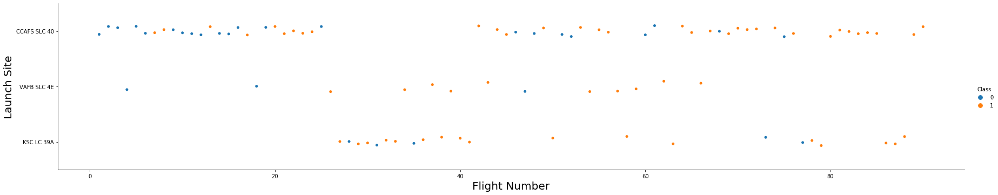
Flight Number vs. Launch Site

Slide 16
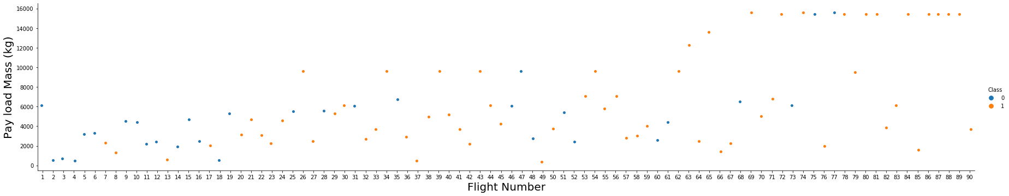
Payload vs. Launch Site

Slide 17
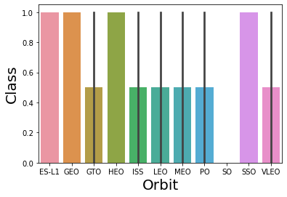
Success Rate vs. Orbit Type
Show a bar chart for the success rate of each orbit type
Show the screenshot of the scatter plot with explanations

Slide 18
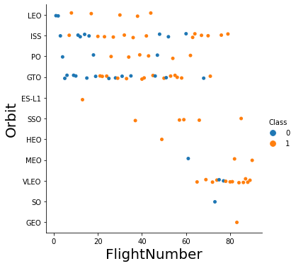
Flight Number vs. Orbit Type

Slide 19
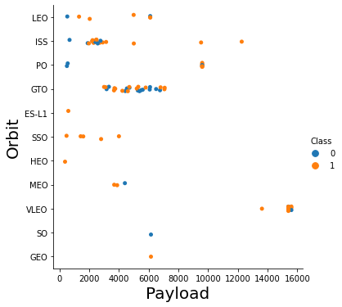
Payload vs. Orbit Type

Slide 20
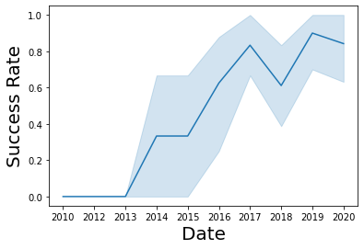
Launch Success Yearly Trend

Slide 21
All Launch Site Names
Find the names of the unique launch sites
Present your query result with a short explanation here

Slide 22
Launch Site Names Begin with 'CCA'
Find 5 records where launch sites begin with `CCA`
Present your query result with a short explanation here

Slide 23
Total Payload Mass
Calculate the total payload carried by boosters from NASA
Total payload carried by boosters from NASA
45596

Slide 24
Average Payload Mass by F9 v1.1
Calculate the average payload mass carried by booster version F9 v1.1
Average payload mass carried by booster version F9 v1.1
2928

Slide 25
First Successful Ground Landing Date
Find the dates of the first successful landing outcome on ground pad
Present your query result with a short explanation here

Slide 26
Successful Drone Ship Landing with Payload between 4000 and 6000
List the names of boosters which have successfully landed on drone ship and had payload mass greater than 4000 but less than 6000
Present your query result with a short explanation here

Slide 27
Total Number of Successful and Failure Mission Outcomes
Calculate the total number of successful and failure mission outcomes
Present your query result with a short explanation here

Slide 28
Boosters Carried Maximum Payload
List the names of the booster which have carried the maximum payload mass
Present your query result with a short explanation here

Slide 29
2015 Launch Records
List the failed landing_outcomes in drone ship, their booster versions, and launch site names for in year 2015

Slide 30
Rank Landing Outcomes Between 2010-06-04 and 2017-03-20
Rank the count of landing outcomes (such as Failure (drone ship) or Success (ground pad)) between the date 2010-06-04 and 2017-03-20, in descending order

Slide 31

Section 3

Slide 32
<Folium Map Screenshot 1>

Slide 33
<Folium Map Screenshot 2>

Slide 34
<Folium Map Screenshot 3>

Slide 35

Section 4

Slide 36
<Dashboard Screenshot 1>
Launch success count for all sites

Slide 37
<Dashboard Screenshot 2>
Pie chart for the launch site with highest launch success ratio

Slide 38
<Dashboard Screenshot 3>
Payload vs. Launch Outcome

Slide 39

Section 5

Slide 40
Classification Accuracy
Visualize the built model accuracy for all built classification models, in a bar chart
Best model: Decision Tree (Accuracy = 88.57%)
Best hyper-parameters:
Criterion: entropy
Max depth: 8
Max. features: auto
Min. samples leaf: 4
Min. samples split: 10
Splitter: random

Slide 41
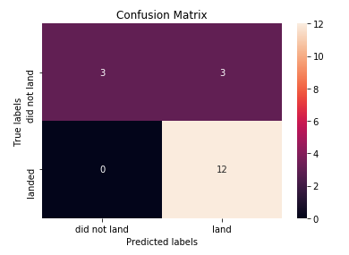
Confusion Matrix
The matrix diagonal represent to the accurate hits of the model, therefore the model correctly predict all lands, but miss some of the examples that did not land, incorrectly classifying half of them as “land”

Slide 42
Conclusions
Models present similar performance
Accuracy always under 90% and over 80%
More data should be necessary to assure the best model

Slide 43
Appendix
Include any relevant assets like Python code snippets, SQL queries, charts, Notebook outputs, or data sets that you may have created during this project

Slide 44


